Slide 1

World Happiness
Prediction
By: Bushra N.
Notes:
Clipnote , problem, strategy throughout, details of changing data or preprocessing, questions we had and what we got, general takeaway from the data, what would you recommend to tweak ml model for more accuracy

Slide 2
Problem
What makes people happy? Mental health and well-being are gaining global attention
Inspired to analyze happiness through the following factors:
Economic
Social
Emotional
Political
Research can be used to improve societal/public infrastructures
Notes:
Mental health and well being is a lot more prioritzed and gaining attention
Therefore we are analyzing happiness through the various factors like economic, social, emotional, and political like how much one has trust in their government
Research and analysis on this data can be used to improve societal and public infrastructures
And Such factors can be taken into consideration for future global development

Slide 3
Dataset Overview
Source: Github (raw data)
Collected between 2005 and 2021
2,089 records and 12 columns
Target: Happiness Score (0–8 scale)
Key predictors: Wealth (log GDP), Social Support, Life Expectancy, Freedom, Generosity, Trust in Government, etc.
Most data scaled 0–1
Notes:
https://raw.githubusercontent.com/csbfx/cs133/main/world_happiness_2005-2021.csv
2,089 records and 12 columns, covering various economic, social, and emotional well-being indicators
Country
Year
Happiness
Wealth
Social Support
Life Expectancy
Freedom
Generosity
Perceived Corruption
Positive Affect - frequency of positive emotions such as happiness, laughter, and enjoyment based on survey responses.
Negative Affect - frequency of negative emotions such as worry, sadness, and anger, also based on survey responses.
Trust in Government
Most variables in the dataset are normalized to a 0–1 scale, with the exception of a few:
Happiness is measured on a 0–8 scale (0 being the worst and 8 the best)
Wealth logarithm of GDP per capita, ranging from ~ 5 to 12
Life Expectancy range between 6 and 75 years

Slide 4
Solution
Strategy
Step 1: Data Cleaning & Preprocessing
Step 2: Exploratory Data Analysis to identify key factors
Step 3: Train multiple ML regression models
Step 4: Compare models using R² and MSE
Goal: Accurately predict happiness and understand driving factors

Slide 5
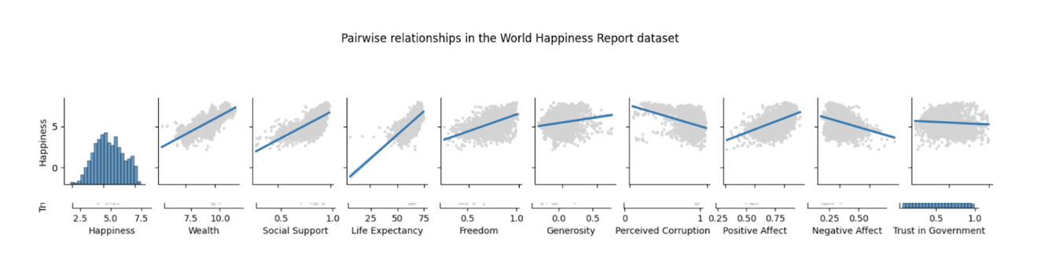
Data Exploration &
Visualization
Used pair plots to spot initial linear relationships and guide feature selection
Heatmaps helped quantify correlation strength between happiness and other variables
Built interactive plots (e.g., line charts, bar charts, box plots) to visually explore trends by country and variable
Clarified key relationships and revealed features with high or low predictive value

Slide 6
Pre-processing
Addressed missing values using mean/median imputation based on data distribution
Removed rows with residual missing data (retained ~92% of dataset)
Checked for duplicates and ensured country name integrity
Column | Missing Values (%) | Missing Count | Replaced with
Perceived Corruption | 5.41% | 113 | Median
Trust in Government | 10.34% | 216 | Mean
Notes:
Given that ‘Trust in Government’ had the highest proportion of missing data (10.34%) and the variable was found to be approximately normally distributed, we imputed missing values using the mean. This approach preserves the distributional characteristics without introducing skew.
For ‘Perceived Corruption’, which displayed a right-skewed distribution, we replaced missing values with the median based of that country to reduce the influence of outliers and maintain central tendency.
Duplicate Records: The dataset was checked for duplicate entries, and none were found.
Country Integrity: The ‘Country’ column was confirmed to contain only unique, valid country names with no anomalies.
Final Dataset Size: After preprocessing, the dataset was reduced from 2,089 records to 1,910 records, resulting in 91.84% data retention. Only 8.16% of the original data was discarded.

Slide 7
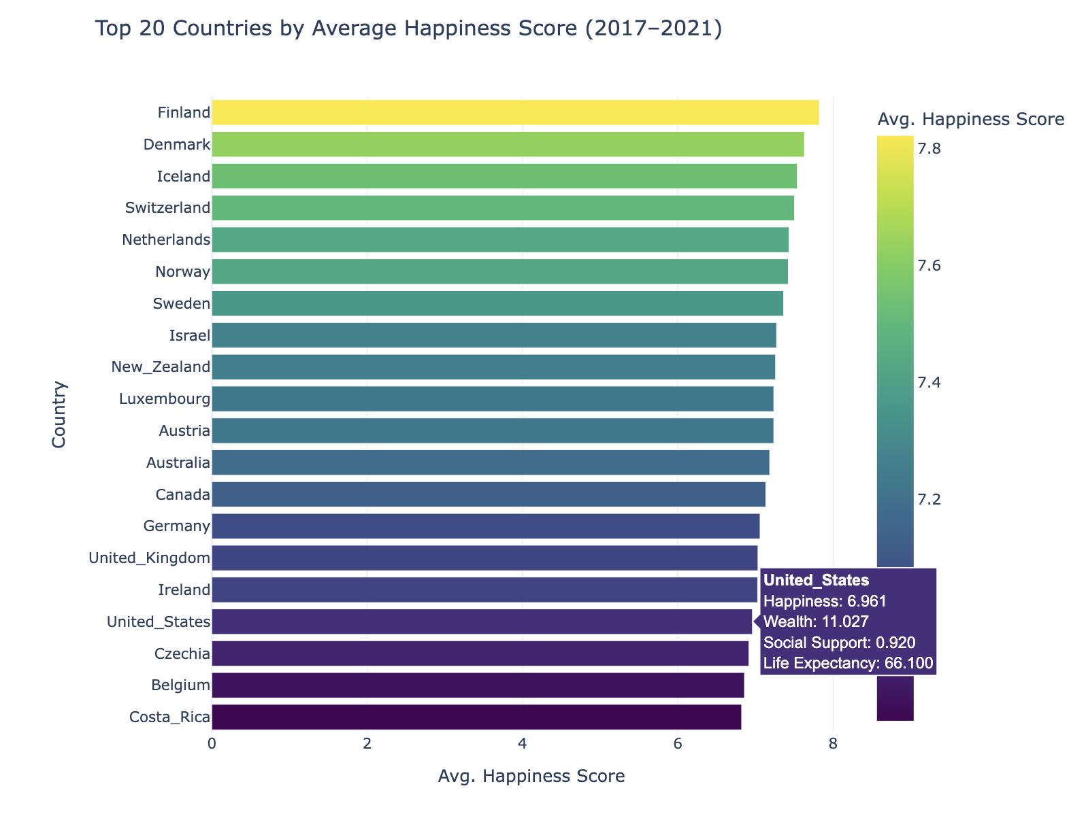
Which countries report the highest happiness scores over the last five years?
Bar chart comparing average happiness in recent years
Interactive feature: Hovering displays average wealth, social support and life expectancy
Nordic countries (Finland, Denmark, Iceland) consistently top the list
Some countries (e.g., Belgium, Costa Rica) had high life expectancy but lower happiness, pointing to the stronger role of social support and wealth
Notes:
basically built an interactive bar chart using plotly to compare the average happiness in the past 5 years
And
The interactive feature is that you can hover over the average happiness, wealth, social support and life expectancy
The ones we see with higher happiness scores consistently are mostly the nordic countries like finland denmark, iceland, and we even have switzerland in there
And something interesting we saw was that some countries had high life expectancy but lower happiness which emphasizes how important social support and wealth are

Slide 8
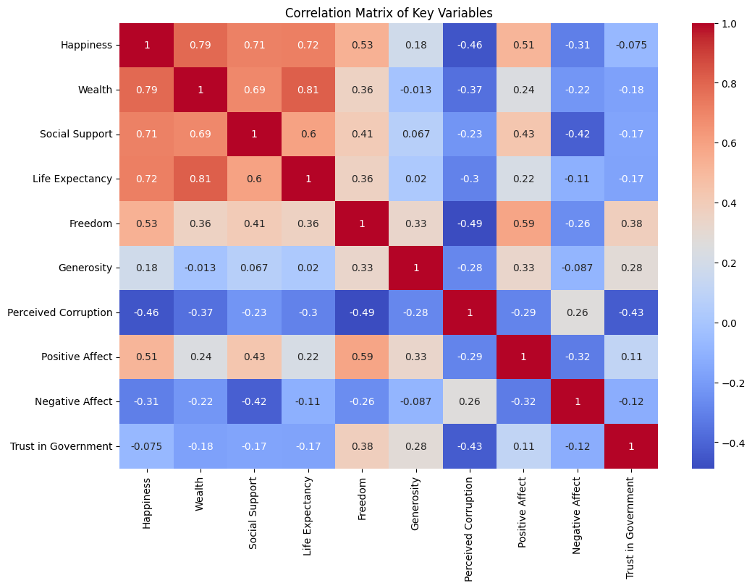
What features are most strongly correlated with happiness?
Strongest positive:
Wealth, Social Support, Life Expectancy
No correlation:
Trust in Government
Notes:
came up with our 5 unique questions and our first one is : what features are most strongly correlated with happiness
We have quite a lot of factors in our dataset but to quantify the relationship between those and happiness, we visualized a correlation matrix of key numerical variables through a heatmap
Some of our observations are that happiness had the strongest correlation with wealth, social support, and life expectancy
Some of the weaker ones were positive affect and negative affect and trust in government which fairly supports our pairplot observation

Slide 9
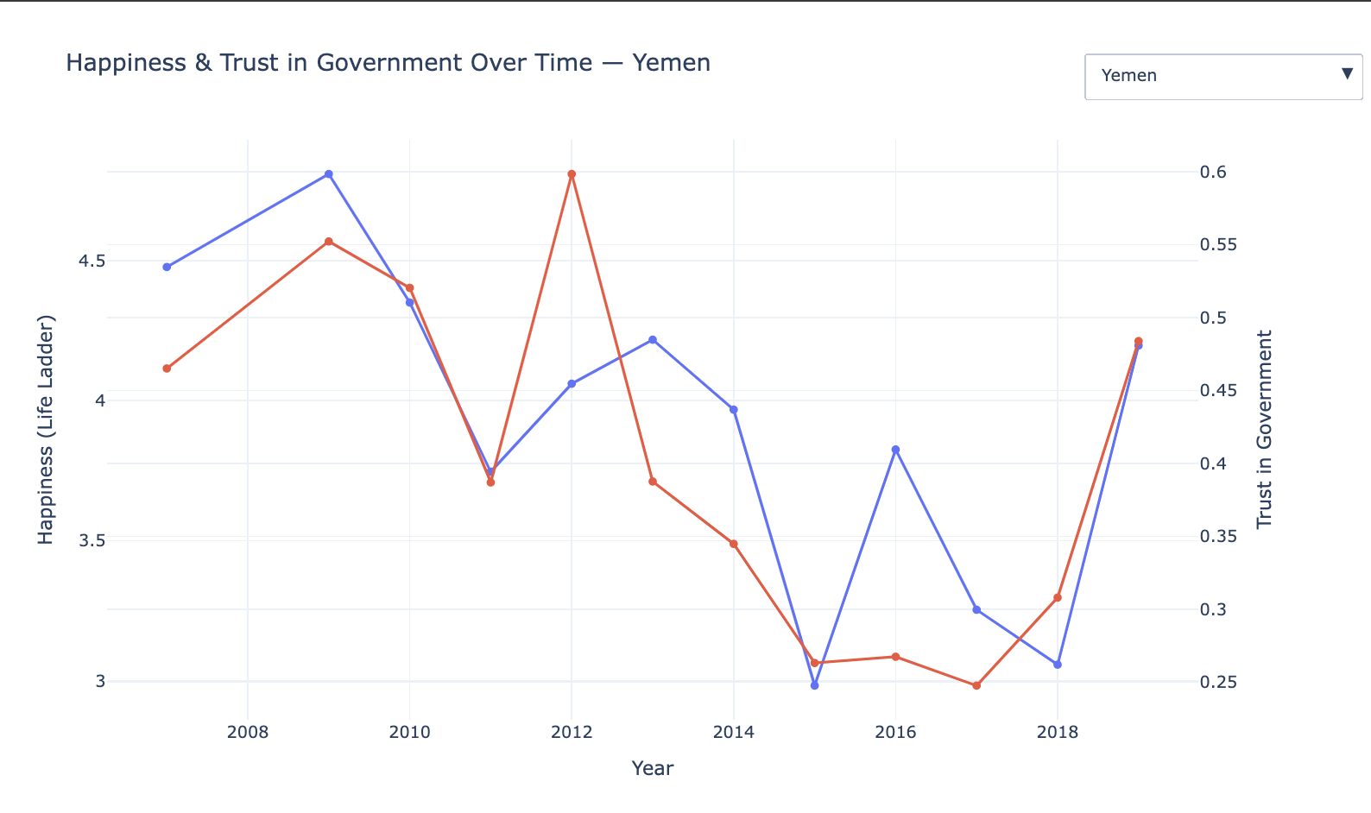
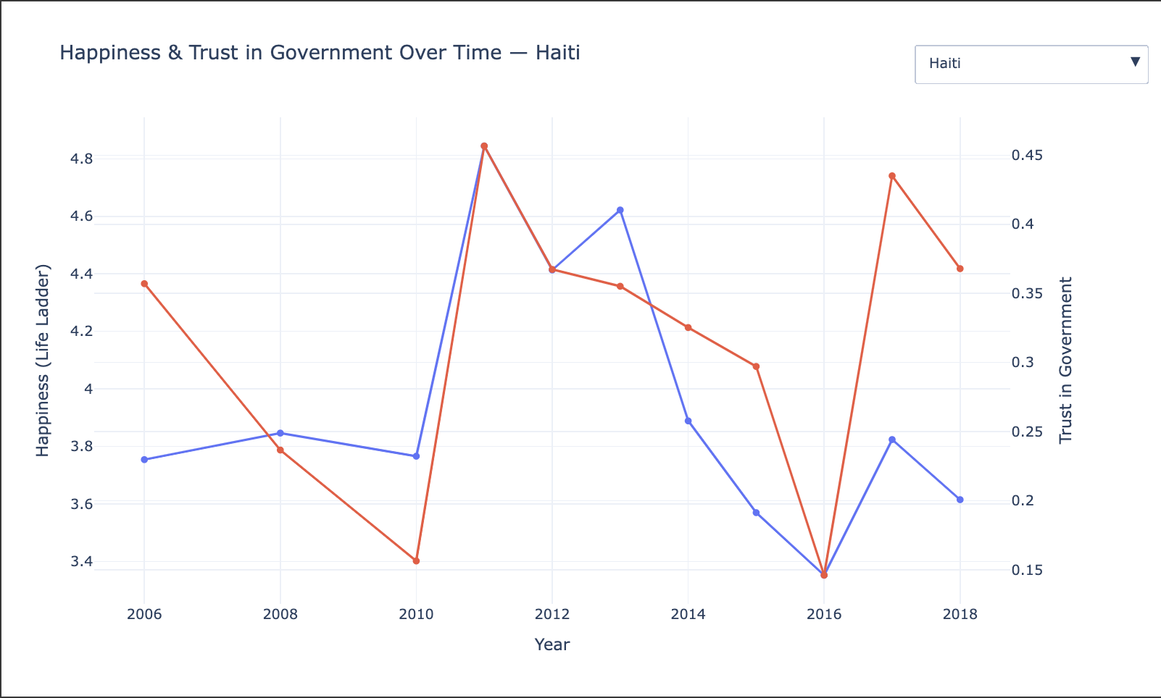

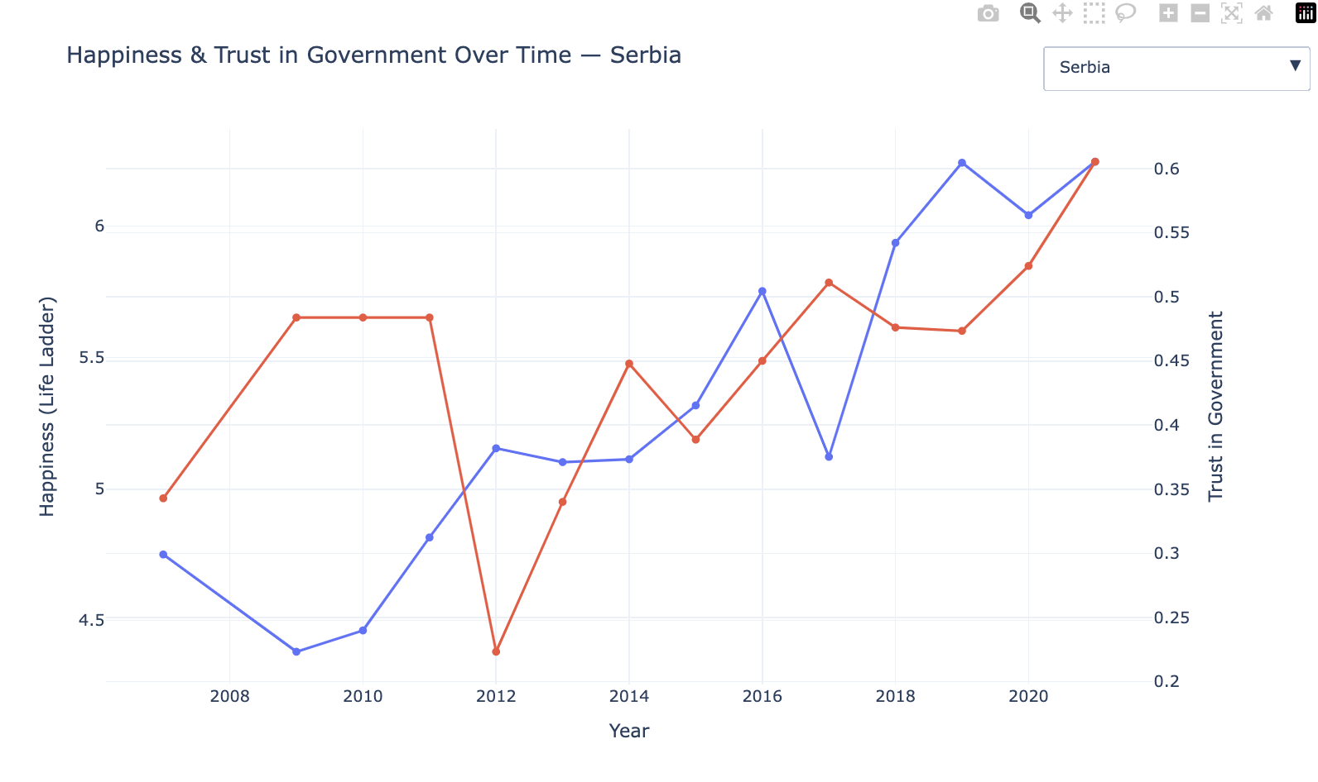
Do countries with higher trust in government report higher happiness?
Created interactive dual-line plot by country over time (drop-down menu)
Only select countries with direct correlation between trust and happiness
General finding: Little to no relationship between trust and happiness GLOBALLY
Exception: Haiti, Yemen, Serbia showed stronger alignment between trust and happiness.
Notes:
Our next question is, do countries with higher trust in government report higher happiness so we created a fun interactive plot, which is a dual-line plot by country over time in which you can use the drop-down menu to select different countries to manually see these trends on the plot
There were only a small number of countries that had correlations and top 3 were Haiti, Yemen, and serbia.
You can see how the blue line which is happiness follows the red line (trust in gov)
Even though these plots might make you think trust in government has a lot of effect on happiness, our overall findings say otherwise, where majority of the countries had little to no correlation with trust in their gov

Slide 10
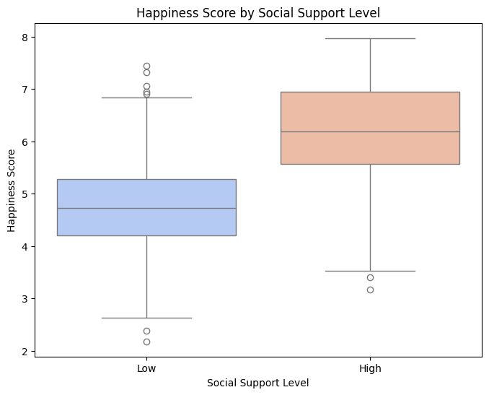
Are there significant differences in happiness between high and low social support countries?
Countries grouped by high vs. low social support (based on median)
Boxplot showed clear trend: higher social support = higher happiness
Confirmed by both visualizations and correlation matrix
Notes:
Our next question is, are there significant differences in happiness between high and low social support countries?
We categorized countries into “High” and “Low” social support groups based on the median and used a boxplot to compare happiness levels.
Some of our observations were that the countries with high “social support” consistently reported higher happiness scores which emphasizes the importance of strong interpersonal and societal networking
This ALSO validated our pairplot and correlation matrix

Slide 11
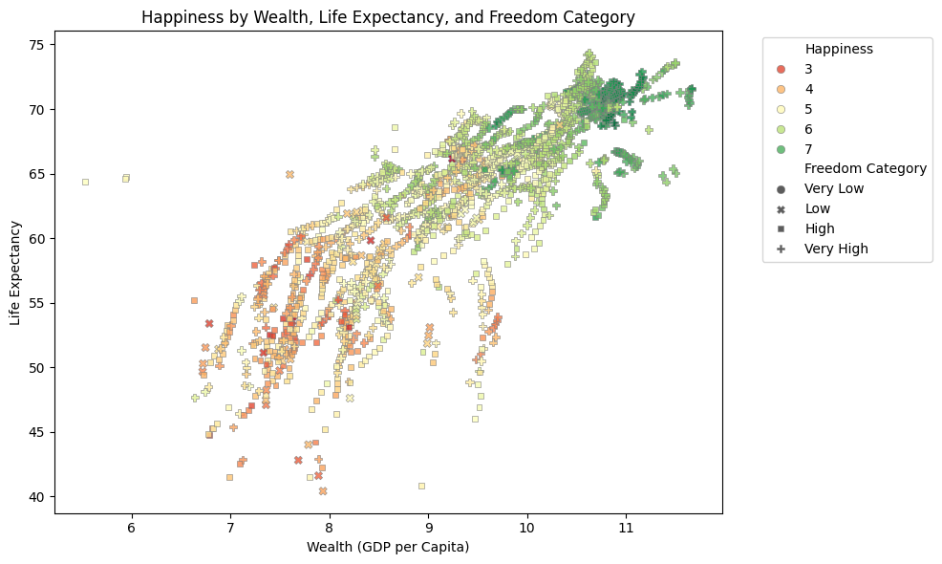
5. How do freedom, wealth, and life expectancy together explain happiness?
Scatter plot showed multi-dimensional interaction:
X = Wealth
Y = Life Expectancy
Hue = Happiness
Style = Freedom
Countries with high wealth, high life expectancy, and high freedom clustered in high happiness range (6–7)
Freedom alone is not a very strong predictor
Haiti removed due to being an extreme outlier (low life expectancy ~40 years)
Notes:
To visualize our last question, how do freedom, wealth, and life expectancy together explain happiness?, we decided to use a scatter plot which showed a multi-dimensional interaction: where
X is wealth, y is life expectancy, hue is happiness, and the style is freedom
From this we can conclude that the countries with high wealth, high life expectancy, and high freedom are clustered in the high happiness range
Freedom is not a very strong predictor as expected from it’s slope in the pairplot and low correlation #, and You see a bunch of squares in the orange/red zone
Haiti was removed due to it being an extreme outlier because it had a very low life expectancy of around 40 years

Slide 12
ML Model
Development
Target variable: Happiness (continuous) → used regression models
Split dataset into 80/20 for training/testing to preserve generalization
Libraries/Tools Used:
Pandas
Seaborn
MatPlotLib
Plotly
Scikit-learn aka sklearn

Slide 13
Regression Models Trained
Models evaluated:
Linear Regression
K-Nearest Neighbors
Decision Tree
Random Forest
Performance Metrics:
R²: measures how well the model fits
MSE: measures average squared error

Slide 14
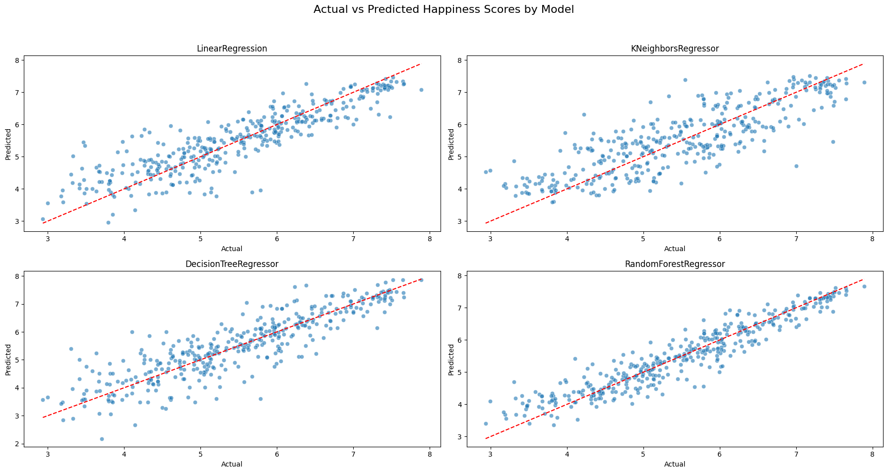
Model | R² Score | MSE
Linear Regression | 0.779 | 0.281
KNN Regressor | 0.680 | 0.407
Decision Tree Regressor | 0.738 | 0.334
Random Forest Regressor | 0.888 | 0.143
Best model: Random Forest Regressor
5-fold CV → R² score of 0.862 (highest)
Hyperparameter tuning using GridSearchCV → R² score of 0.885 and MSE of 0.146
Notes:
Tried dropping weak features (Trust in Government, Generosity, Affect scores) — had minimal effect on score, which is good because it simplifies the model
Apply cross-validation to avoid overfitting (avg of 5 r sq values)
GridSearchCV tuning on Random Forest:
Optimized depth, estimators, split criteria, etc.
Final R² = 0.885, MSE = 0.146 — very close to untuned model but with slightly more control
Feature testing confirmed top 3 drivers: Wealth, Social Support, Life Expectancy
Hyper Parameters
The following parameters were tested: number of estimators (50, 100, 200), maximum depth (None, 10, 20), minimum samples required to split an internal node (2, 5), minimum samples required at a leaf node (1, 2), and the number of features considered at each split ('auto', 'sqrt').
The optimal combination of hyperparameters was found to be: max depth of 20, max features set to 'sqrt', minimum samples per leaf of 1, minimum samples per split of 2, and 100 estimators. This configuration yielded an R² score of 0.885 and a mean squared error (MSE) of 0.146.

Slide 15
General Takeaway
Top contributors to happiness: Wealth, Social Support, Life Expectancy
Trust in government had surprisingly little impact overall
Initial plan to drop all NaNs caused major data loss — targeted imputation worked better
ML model refinement showed that some features have minimal predictive power
Combining data exploration and ML helped uncover both insightful patterns and practical predictors
Notes:
So our general takeaway from analyzing this dataset is that the Top contributors to happiness are Wealth, Social Support, Life Expectancy
The Trust in government had surprisingly very little impact on the happiness score however some selected countries had a strong alignment
Our Initial plan to drop all NaNs caused data loss and a better way to go about it was to target imputation
And our Machine Learning model refinement showed that some features have very minimal predictive power
But Combining data exploration and ML helped uncover both insightful patterns and predicting factors which can be very useful for future developments
Some of our struggles throughout would be handling missing data, at first dropping those values seemed straightforward but it removed far more data than we anticipated so imputing the values

Slide 16
Questions?

